Slide 1
Final Presentation SPL1
Project name : nazeeb_server, a mail server
Presented by Supervised By
Nazeeb Ahmed Chowdhury Associate Professor
Bsse 1432 Kishan Kumar Ganguly

Slide 2
What the Project does:
A simplified multi threaded mail server

Slide 3
What the Project does:
A simplified multi threaded mail server
Provides unique mail addresses to users while signing up

Slide 4
What the Project does:
A simplified multi threaded mail server
Provides unique mail addresses to users while signing up
Users can send mail using mail addresses

Slide 5
What the Project does:
A simplified multi threaded mail server
Provides unique mail addresses to users while signing up
Users can send mail using mail addresses
Read or Delete mails from their mail box

Slide 6
What the Project does:
A simplified multi threaded mail server
Provides unique mail addresses to users while signing up
Users can send mail using mail addresses
Read or Delete mails from their mail box
user authentication through hashed passwords(SHA 256), adding a layer of security to protect user credentials

Slide 7
What the Project does:
A simplified multi threaded mail server
Provides unique mail addresses to users while signing up
Users can send mail using mail addresses
Read or Delete mails from their mail box
user authentication through hashed passwords(SHA 256), adding a layer of security to protect user credentials
Can handle multiple clients

Slide 8
Concepts Related to my project
Socket Programming

Slide 9
Concepts Related to my project
Socket Programming
SHA 256 Hashing Algorithm

Slide 10
Concepts Related to my project
Socket Programming
SHA 256 Hashing Algorithm
File Handling and Directory Operations

Slide 11
Concepts Related to my project
Socket Programming
SHA 256 Hashing Algorithm
File Handling and Directory Operations
Multi threading and Concurrent Processing

Slide 12
Concepts Related to my project
Socket Programming
SHA 256 Hashing Algorithm
File Handling and Directory Operations
Multi threading and Concurrent Processing
IMAP Protocol

Slide 13
Server Architecture
3 segments within the server

Slide 14
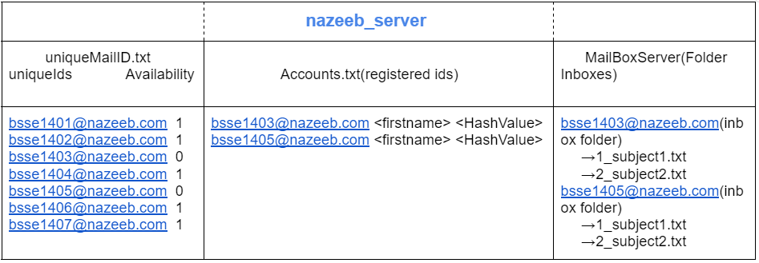
Server Architecture
3 segments within the server

Slide 15
Main Programe Parts
myhelper folder :

Slide 16
Main Programme Parts
myhelper folder : checks server and client arguments and performs necessary file and directory operations

Slide 17
Main Programme Parts
myhelper folder : checks server and client arguments and performs necessary file and directory operations
SHA-Algo folder: responsible for computing the hash value of passwords

Slide 18
Main Programme Parts
myhelper folder : checks server and client arguments and performs necessary file and directory operations
SHA-Algo folder: responsible for computing the hash value of passwords
mysocket folder: has all the necessary codes for socket programming

Slide 19
Main Programme Parts
myhelper folder : checks server and client arguments and performs necessary file and directory operations
SHA-Algo folder: responsible for computing the hash value of passwords
mysocket folder: has all the necessary codes for socket programming
Validate_signup.cpp: programme for server to provide unique id to a new user and register the userID,firstname and Hashed Password into Accounts.txt file

Slide 20
More Main Programme Parts
myclient.cpp : programme for clients to signup,login and request fundamental mail operations (like SEND,READ,LIST,DELETE,LOGOUT) to server.

Slide 21
More Main Programme Parts
myclient.cpp : programme for clients to signup,login and request fundamental mail operations (like SEND,READ,LIST,DELETE,LOGOUT) to server.
myserver.cpp : server programme to handle client requests of mail operations and make directories(client inboxes) to store received messages.

Slide 22
Sample Input Output

Slide 23
Sample Input Output
Snap of the working of SHA 256 algo:

Slide 24
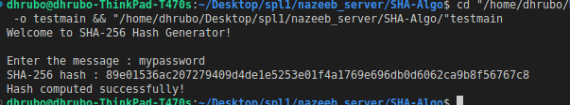
Sample Input Output
Snap of the working of SHA 256 algo:

Slide 25
Sample Input Output
Setting Up the server:

Slide 26
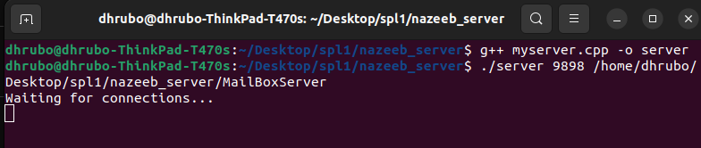
Sample Input Output
Setting Up the server:
Programme name
Port number
ArgDirectory of MailBoxServer

Slide 27
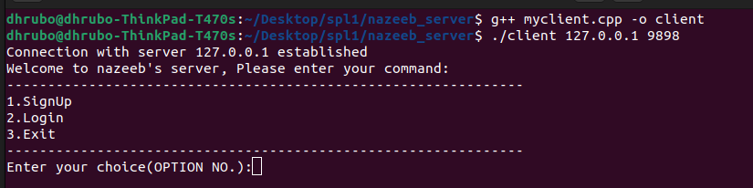
Sample Input Output
Setting Up the client:

Slide 28
Sample Input Output
Setting Up the client:
Server IP Address

Slide 29
Sample Input Output
Setting Up the client:
Server IP Address
Server port Number

Slide 30
Sample Input Output
Setting Up the client:
Server IP Address
Server port Number

Slide 31
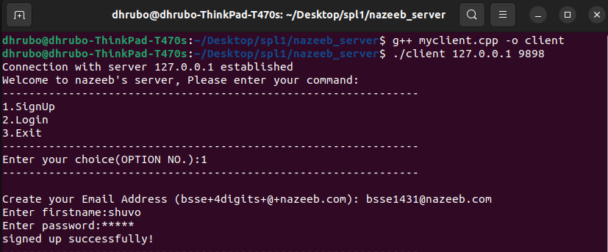
Sample Input Output
Signing up operation for client

Slide 32
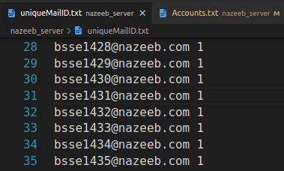
Sample Input Output
Before:
Before signing up, 1431 was available in the server.

Slide 33
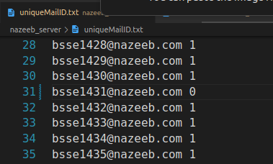
Sample Input Output
After:
After signing up the 1431 unique id becomes unavailable to any other new user

Slide 34
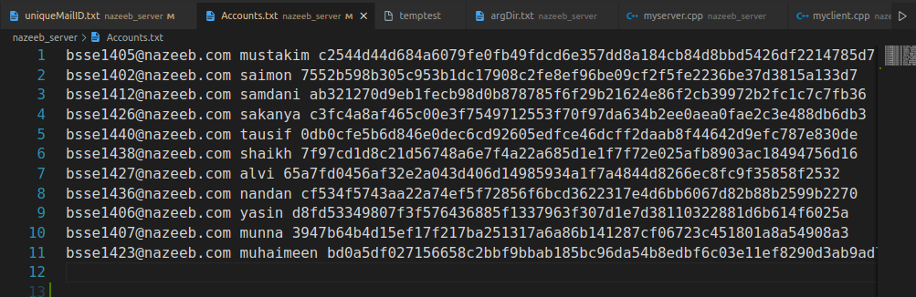
Sample Input Output
Before:
New user will be registered here,userid+firstname+hashedPassword

Slide 35
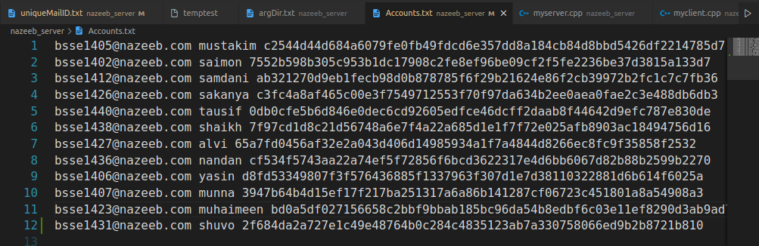
Sample Input Output
After:
New signed up user is registered in the Server’s Account.txt file!!

Slide 36
Sample Input Output
After login operation snaps:
Client:-

Slide 37
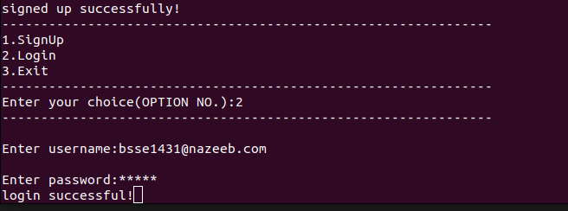
Sample Input Output
After login operation snaps:
Client:-
Input Password is hashed and is cheked with the registered hashValue

Slide 38
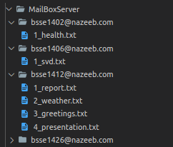
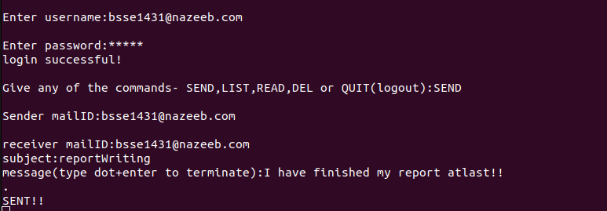
Sample Input Output
After login operation snaps:
Client:-
No inbox folder for bsse1431 exists has there is 0 message
Message composed and sent to bsse1431

Slide 39
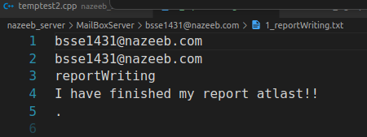
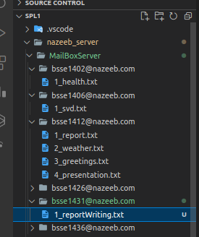
Sample Input Output
Sender
Receiver
Subject
Message
After login operation snaps:
Client:-
New directory created in MailBoxServer as a message is received by bsse31

Slide 40
Sample Input Output
After login operation snaps:
Server:-
Backend message in the server after sending mail message to receiver

Slide 41
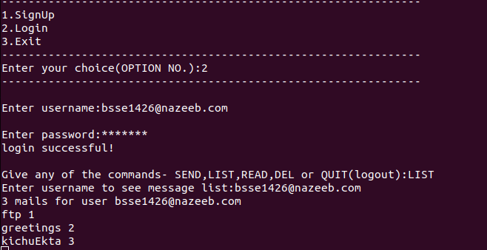
Sample Input Output
After login operation snaps:
LIST command from client to show the list of messages
List of messages

Slide 42
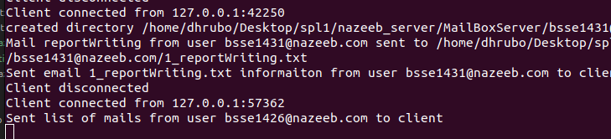
Sample Input Output
After login operation snaps:
Backend server:
Backend server message for sending list of mail subjects to client

Slide 43
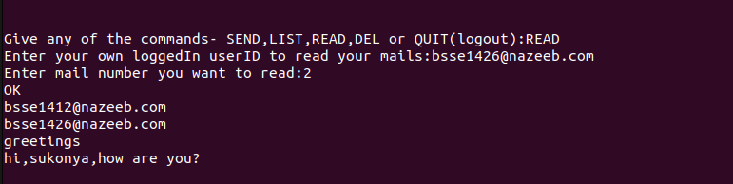
Sample Input Output
After login operation snaps:
Read operation for client

Slide 44
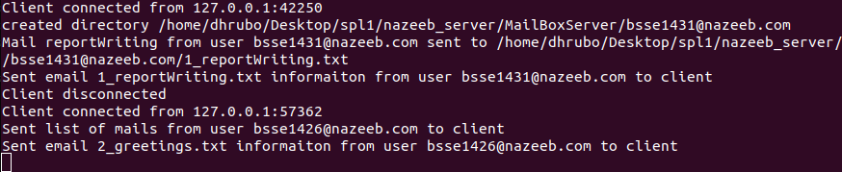
Sample Input Output
Read operation for client
After login operation snaps:
Backend Server message

Slide 45
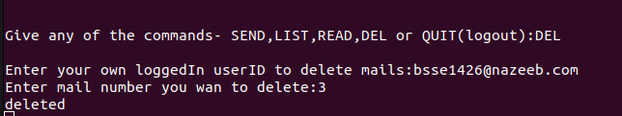
Sample Input Output
After login operation snaps:
Client:-

Slide 46
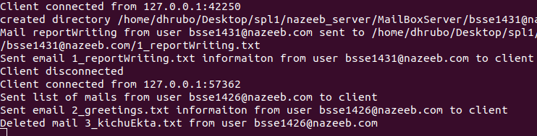
Sample Input Output
Delete operation
After login operation snaps:
Client:-
Server:-
Backend server message for deletion

Slide 47
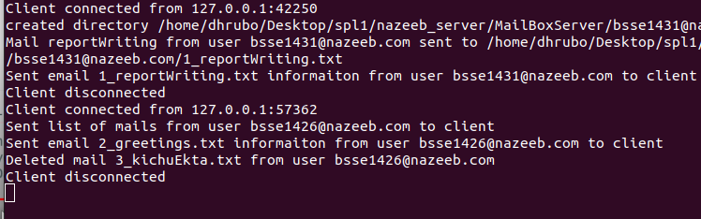
Sample Input Output
After login operation snaps:
Server still active even if one client is disconnected

Slide 48
Limitations and Future enhancement
Acknowledging the limitations of this project, there is room for enhancement and expansion. Implementing advanced features such as attachments, searching, spam filtering, and integrating with external services like LDAP were identified as potential areas for future development.It can be expanded where two pcs can communicate with each other.

Slide 49
Challenges faced
I had some problems with maintaining the uniqueness of new incoming file.As UUID is not supported in c++, I had to come up with a solution to provide a unique mailID to each of the incoming messages.I did that by counting the number of total messages present in the inbox folder of a user and then incrementing it by one. Then I named the new message file by “ mailID_subject.txt”

Slide 50
Challenges faced
2 . When entering the mail number that I want to read or delete, the server was doing the operation on wrong mail message. Therefore, it was seen that if i entered mail number 2 to delete, mail number 3 would have gotten deleted.If I entered mail number 2 to read, the server would send me mail number 3 to read.
I solved this problem by simply sorting the mails vector.Then it worked properly

Slide 51
Challenges faced
3. I faced a challenge to ensure that no unexpected character was in the buffer. To ensure this, I have written cin.ignore() in some places of my code.
But even after this, the client process sometimes terminates unexpectedly when pressing enter.
That I couldn’t figure out , so, the programme has this small problem.
To continue running the programme,user just have to type “UpArrow+enter” to continue running his programme.

Slide 52
Conclusion
In conclusion, the development and implementation of the Mail Server project have provided valuable insights into the complexities of designing a robust and secure email communication system. This project aimed to create a simplified mail server that supports essential functionalities such as user registration, login, sending, receiving, listing, reading, and deleting emails.

Slide 53
REFERENCES
1)Socket programming Basics:-
https://marketsplash.com/tutorials/cpp/cplusplus-scoket/
2)Full implementation of SHA 256:-
https://youtu.be/9xs4eWOAG7Y?si=PKqyv2k-zyQq0kdQ
3)Mail server Protocols:-
https://www.geeksforgeeks.org/email-protocols/

Slide 54
THANK YOU!!

